Slide 1

Machine Learning Systems Design
Lecture 8: Deployment
CS 329 | Chip Huyen

Slide 2
Logistics
No assignment 3 so you have more time for final project
If need help with final project, private Piazza
Mentorship with Pete Warden?

Slide 3
Project’s general feedback
Healthcare
Be very, very careful of what predictions to show to users
Data privacy!
Evaluation
Might need to try different metrics to see what works best for your use case
Critical slices
Mobile app
If not familiar with Android/iPhone app development, try simple web interface

Slide 4
Project’s general feedback
MVP not MVP enough
Online learning
Federated learning
Knowledge distillation
Databases
CI/CD

Slide 5
Project’s general feedback
MVP not MVP enough
Online learning
Federated learning
Knowledge distillation
Databases
CI/CD

Slide 6
Suggested P0s
Get data
Have a baseline with a metric that you think is the best right now
[P0] Better than random (for milestone 2)
[P1] Good enough (for demo)
[P2] Great (can possibly get a paper/startup out of this)
Understand data
Extract features
Train a simple model that is better than baseline P0 to validate data
Don’t worry about the latency, compression just yet
Hook it into a simple pipeline
Simple user interface (even just a website for users to enter input and get input back is fine)
Do inference on each incoming request (no need to wait and do them in batch)
Print things on screen or in a log file

Slide 7
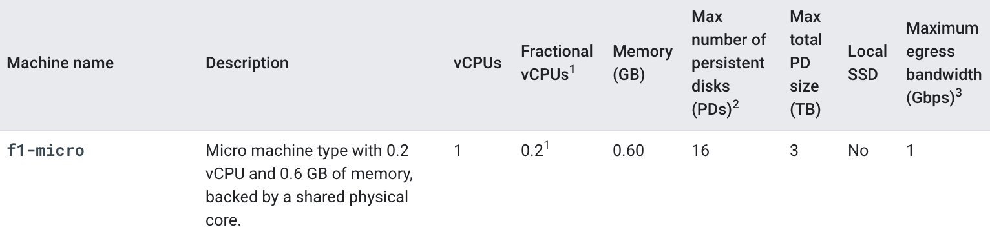
Compute tips (on top of class credits)
Colab has access to free GPU/TPU
GCP credits for new user $300
GCP free-tier always-free f1-micro
Should be enough to run simple apps

Slide 8
Agenda
Model compression & optimization
Simple deployment
Containerized deployment
Test in production
OpenAI API workshop

Slide 9
Model compression & optimization

Slide 10


Latency matters
Latency 100 -> 400 ms reduces searches 0.2% - 0.6% (2009)
30% increase in latency costs 0.5% conversion rate (2019)

Slide 11
No matter how great your ML models are,
if they take just milliseconds too long,
users will click on something else.

Slide 12
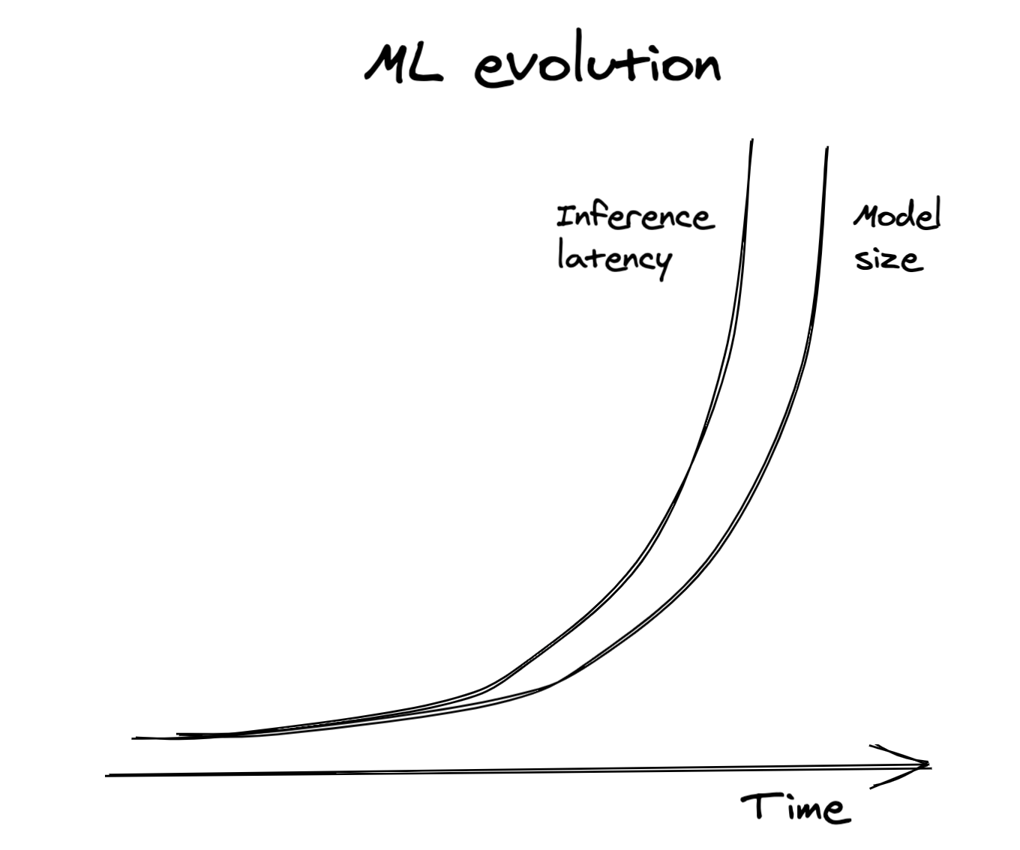
Bigger, better, slower

Slide 13

Fast inference
Make models faster
Make models smaller
Make hardware more powerful

Slide 14
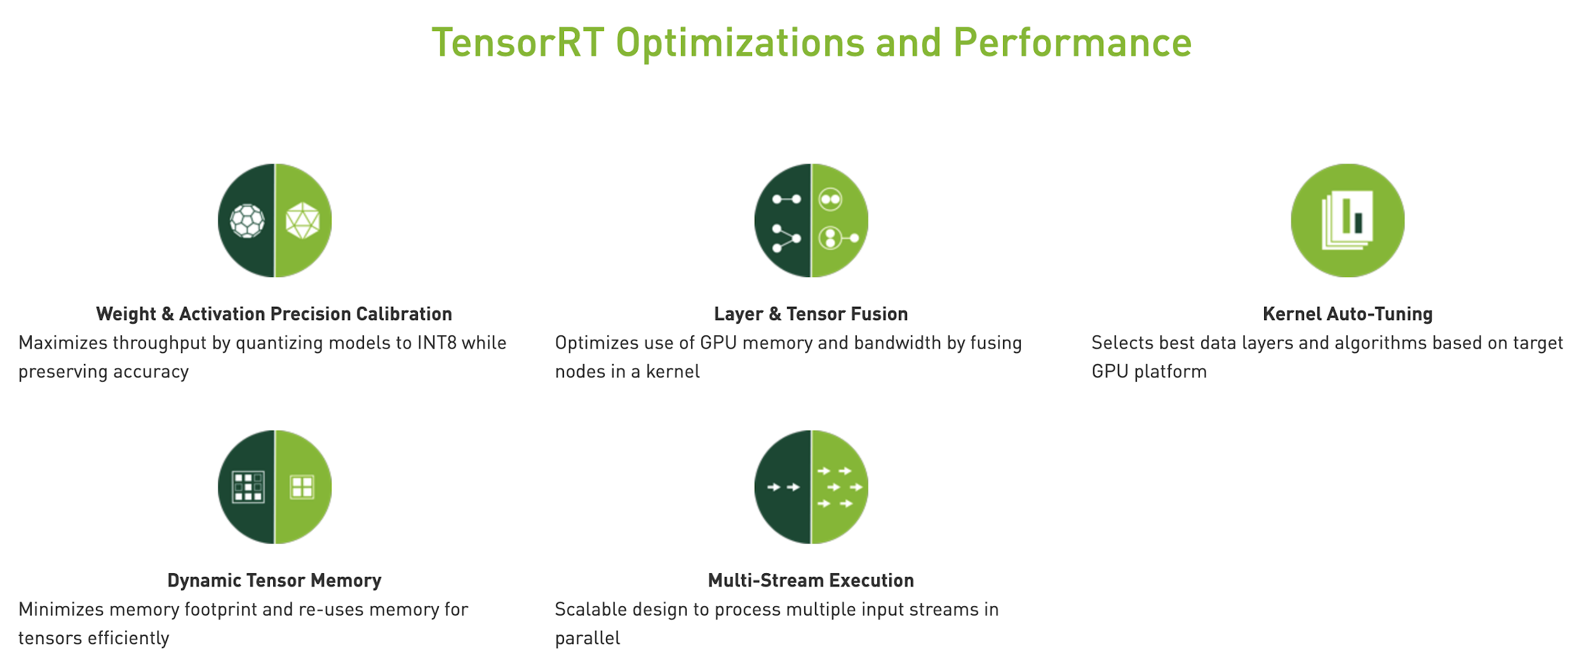
Make models faster
Inference optimization

Slide 15
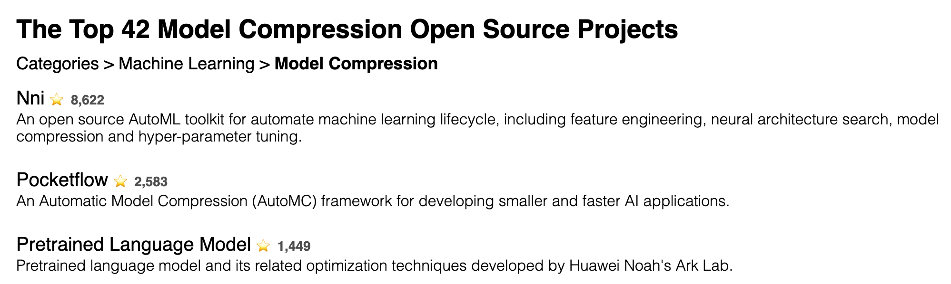
Make models smaller
Model Compression
Quantization | Knowledge distillation
Pruning | Low-ranked factorization
https://awesomeopensource.com/projects/model-compression

Slide 16
There is No Free Lunch!
Model
“Expressiveness”
Smaller Model
(Fewer Parameters)

Slide 17
Model compression: quantization
Reduces the size of a model by using fewer bits to represent parameter values.
E.g. half-precision floating point (16-bit), or integer (8-bit) representations
Notes:
Pros:
Reduces memory footprint and computation speed
Cons:
Rounding errors can have downstream effects.
Rounding can lead to over/under-flow, or zeroing.
Non-trivial to implement efficient rounding/scaling.

Slide 18
Model compression: knowledge distillation
Train a small model (“student”) to mimic the results of a larger model (“teacher”).
Teacher & student can be trained at the same time.
E.g. DistillBERT, reduces size of BERT by 40%, and increases inference speed by 60%, while retaining 97% language understanding.
Notes:
Pros:
Fast to train student network if teacher is pre-trained.
Teacher and student can be completely different architectures.
Cons:
If teacher is not pre-trained, may require larger dataset and training time, because you first have to train the complex, expressive teacher model, then train the student model.

Slide 19
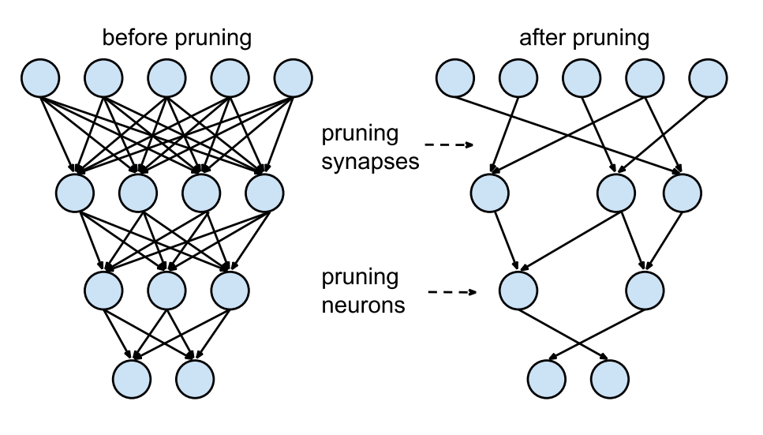
Source: Han et al., 2015 (arXiv:1506.02626)
Model compression: pruning
Doesn’t reduce number of parameters; reduces the number of nonzero parameters.
Efficient storage schemes for sparse data.
Can prune either weights or neurons:
Weights: set weights which are almost zero to zero.
Neurons: neurons with invariant activations can be removed.
Learning both Weights and Connections for Efficient Neural Networks, Han et al., 2015.
Notes:
Sparse structures require less space (sparse < 67% of dense)
Dense: 8 bytes per number
Sparse: 12 bytes (double + index)
Pros:
Reduce model size, if efficient sparse storage scheme.
Can be interpreted as a form of architecture search.
Cons:
Requires an efficient storage scheme.

Slide 20
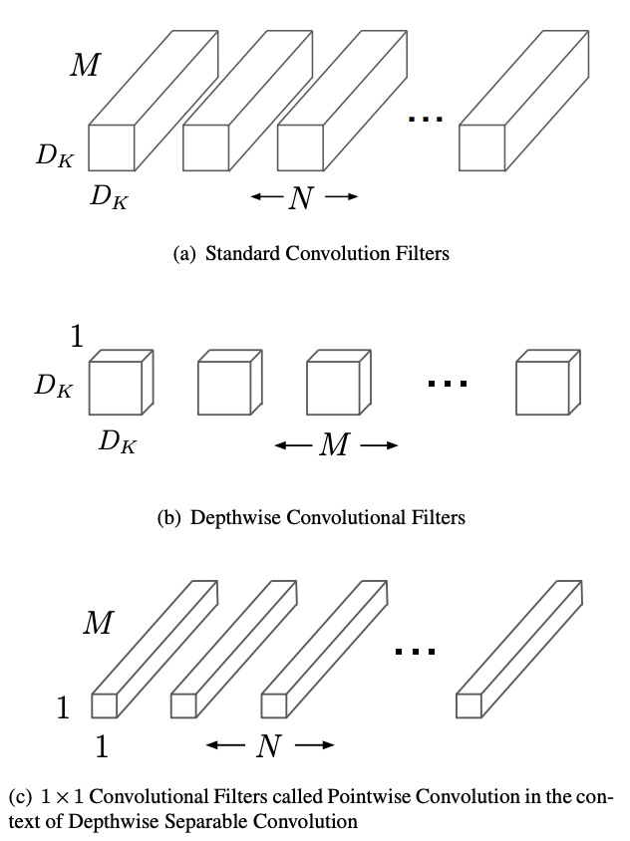
Model compression: factorization
Insight: 3 x 3 matrix can be written as a product of 3 x 1 and 1 x 3
6 params instead of 9
Replace convolution filters (many parameters) with compact blocks (fewer parameters)
E.g. MobileNets: The standard convolutional filters in (a) are replaced by depthwise convolution in (b) and pointwise convolution in (c) to build a depthwise separable filter.
MobileNets: Efficient Convolutional Neural Networks for Mobile Vision Applications, Howard et al., 2017.
Notes:
Matrix factorization: 3x3 can be product of two 3x1 matrices, so 6 parameters instead of 9.
Factorize to lower rank matrices.

Slide 21
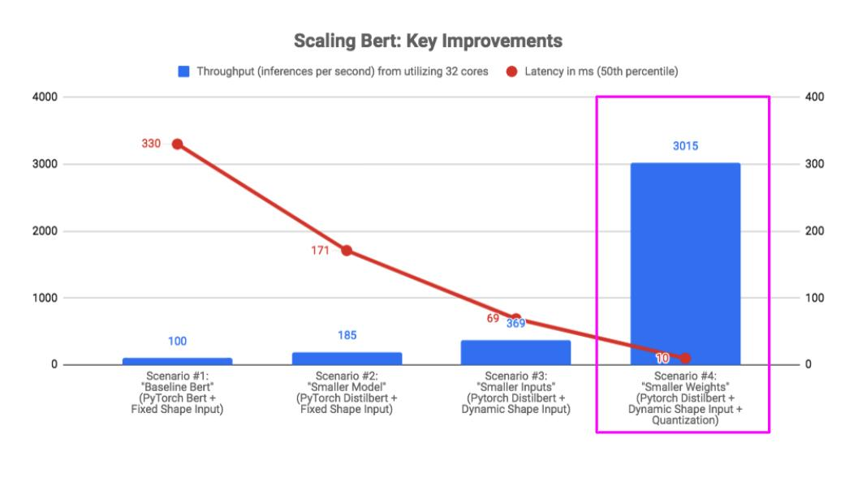
Make models smaller: case study
How We Scaled Bert To Serve 1+ Billion Daily Requests on CPUs (Roblox, 2020)
Notes:
Roblox - needed a BERT to serve >1 billion requests a day, while running on CPU.
They started with a large BERT model with fixed shape input, then replaced BERT with DistilBERT and fixed shape input with dynamic shape input, and finally quantized it.
(Quantization has the most input).
Reduced latency by 30x!!
However - they don’t discuss quality of output in their report… so take this with a grain of salt.

Slide 22
Make hardware more powerful
Hardware startup | Raised ($) | Year founded | Location
Graphcore | 682 | 2016 | UK
SambaNova | 465 | 2017 | Bay Area
Nuvia | 293 | 2019 | Bay Area
Wave Computing | 203 | 2008 | Bay Area
Cambricon | 200 | 2016 | China
Cerebras | 112 | 2016 | Bay Area
Hailo | 88 | 2017 | Israel
Habana Labs | 75 | 2016 | Israel
Kneron | 73 | 2015 | San Diego
Prophesee | 65 | 2014 | France
Syntiant | 65 | 2017 | LA
Groq | 62 | 2016 | Bay Area
EdgeQ | 53 | 2018 | Bay Area
LeapMind | 50 | 2012 | Japan
Training & inference
Server & edge
Will cover this in TinyML lecture!

Slide 23
Simple deployment
We’ve trained a model. Now what?

Slide 24
Deploy a model on cloud
GCP AI Platform Prediction
AWS Sagemaker
Create predictor*
Hosted model
Upload model
Create function
Endpoint
Train model
Compress model
Export model
GCP Cloud Functions
AWS Lambda
Create app
Sync app
(git repo)
Hosted app
GCP App Engine
AWS EC2

Slide 25
Export a model
Turn models into binary formats
scikit-learn, XGBoost -> joblib, pickle
TensorFlow -> .save()
PyTorch -> .save()

Slide 26
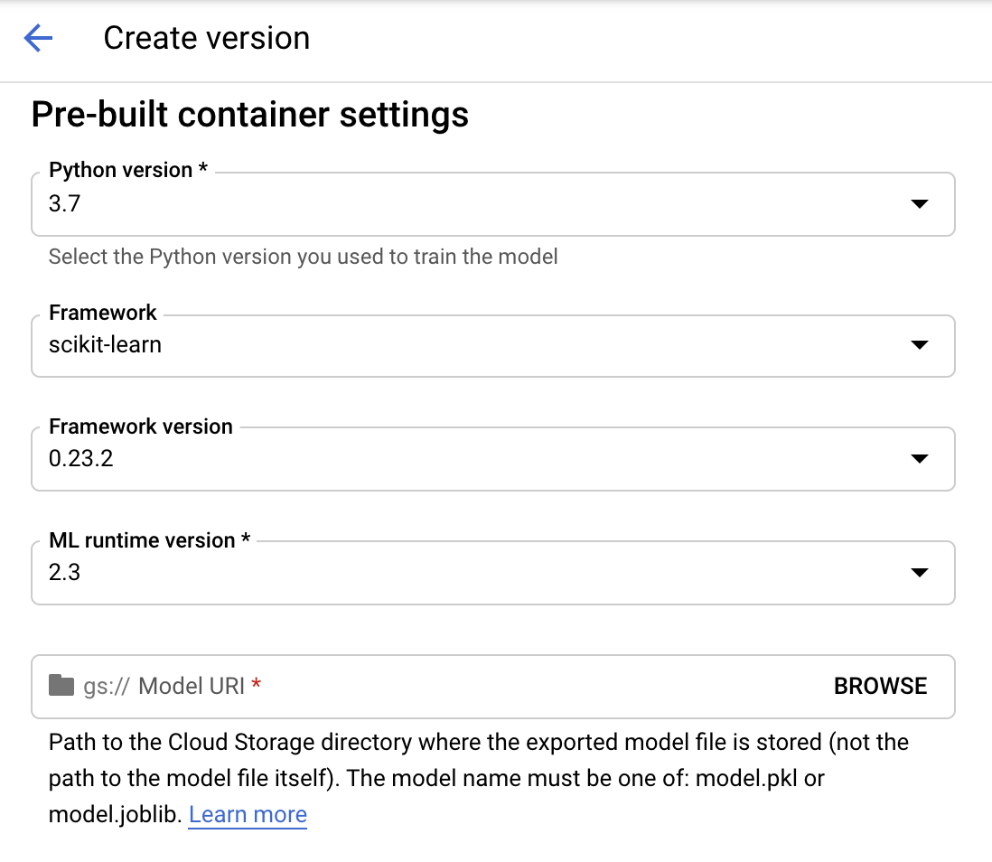
GCP AI Platform: hosted model
Upload model to cloud storage
Create a version for your model

Slide 27
GCP AI Platform: hosted model
Upload model to cloud storage
Create a version for your model
Output looks like this
{ "name": "projects/[YOUR-PROJECT-ID]/operations/create_[YOUR-MODEL-NAME]_[YOUR-VERSION-NAME]-[TIMESTAMP]", "metadata": { "@type": "type.googleapis.com/google.cloud.ml.v1.OperationMetadata", "createTime": "2018-07-07T02:51:50Z", "operationType": "CREATE_VERSION", "modelName": "projects/[YOUR-PROJECT-ID]/models/[YOUR-MODEL-NAME]", "version": { "name": "projects/[YOUR-PROJECT-ID]/models/[YOUR-MODEL-NAME]/versions/[YOUR-VERSION-NAME]", "deploymentUri": "gs://your_bucket_name", "createTime": "2018-07-07T02:51:49Z", "runtimeVersion": "2.3", "framework": "[YOUR_FRAMEWORK_NAME]", "machineType": "[YOUR_MACHINE_TYPE]", "pythonVersion": "3.7" } } }

Slide 28
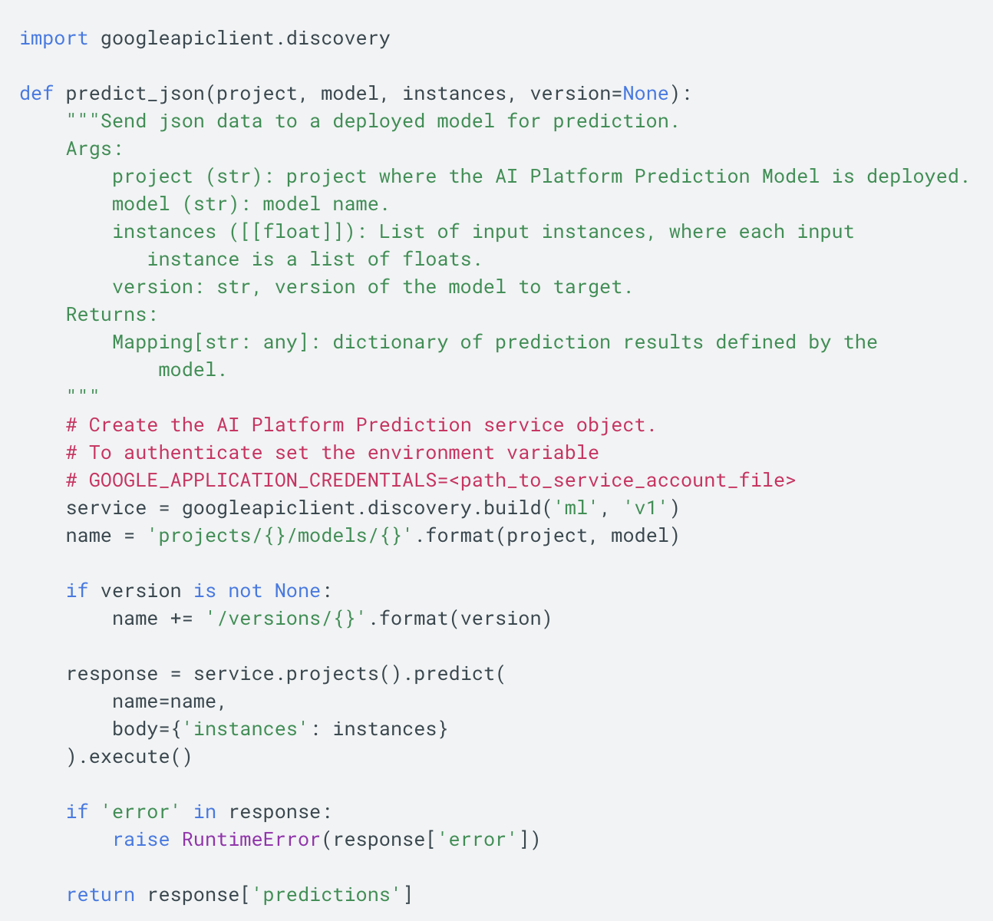
GCP AI Platform
Train model
Deploy a model & version
Make online/batch predictions

Slide 29
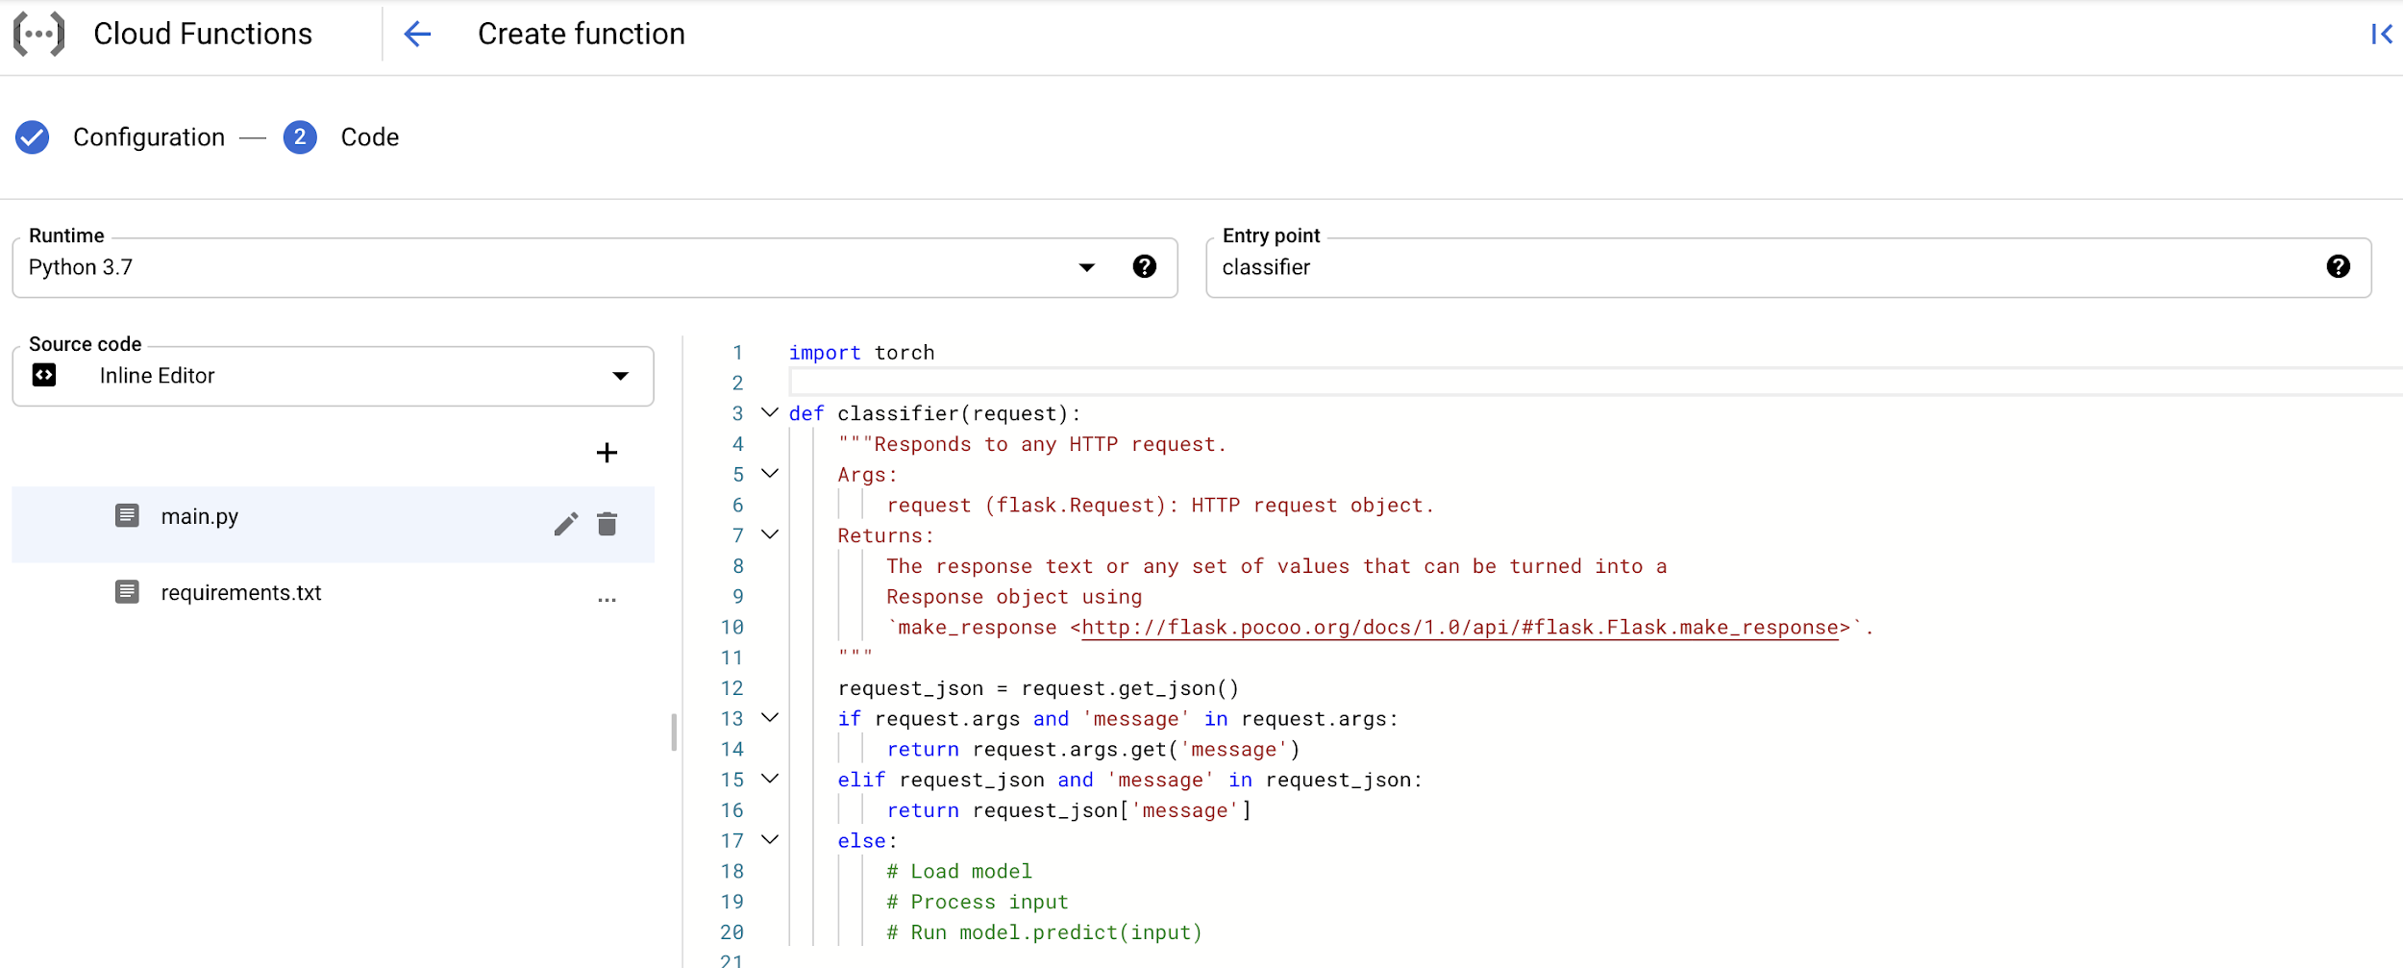
GCP Cloud Functions: endpoint
Create a function

Slide 30
GCP Cloud Functions: endpoint
Create a function -> hosted endpoint (e.g. HTTP trigger)
Access endpoints
curl -X POST "https://YOUR_REGION-YOUR_PROJECT_ID.cloudfunctions.net/FUNCTION_NAME" -H "Content-Type:application/json" --data '{"sentence":"This tweet is supposed to be very angry."}'

Slide 31
GCP App Engine: hosted app
Clone your GitHub repo into your Gcloud project directory
main.py
app.yaml
requirements.txt

Slide 32
GCP App Engine: hosted app
Clone your GitHub repo into your Gcloud project directory
main.py: define endpoint for predict
@app.route('/predict', methods=['POST']) def predict(): X = request.get_json()['X'] y = MODEL.predict(X).tolist() return json.dumps({'y': y}), 200

Slide 33
GCP App Engine
Clone your GitHub repo into your Gcloud project directory
main.py: define endpoint for predict
app.yaml: define app environment e.g. variables, where the exported model is located
env_variables: # The app will look for the model file at: gs://MODEL_BUCKET/MODEL_FILENAME MODEL_BUCKET: BUCKET_NAME MODEL_FILENAME: sentiment_classifier.pkl

Slide 34
GCP App Engine
Clone your GitHub repo into your Gcloud project directory
main.py: define endpoint for predict
app.yaml: define app environment e.g. variables, where the exported model is located
requirements.txt: dependencies
numpy scikit-learn torch fastapi

Slide 35
GCP App Engine: hosted app
Clone your GitHub repo into your Gcloud project directory
Initialize: gcloud init
Deploy: gcloud app deploy
View your app in browser: gcloud app browse
https://PROJECT_ID.REGION_ID.r.appspot.com

Slide 36
Containerized deployment

Slide 37
GCP runtime version
GCP AI Platform Prediction revisited
{ "name": "projects/[YOUR-PROJECT-ID]/operations/create_[YOUR-MODEL-NAME]_[YOUR-VERSION-NAME]-[TIMESTAMP]", "metadata": { "@type": "type.googleapis.com/google.cloud.ml.v1.OperationMetadata", "createTime": "2018-07-07T02:51:50Z", "operationType": "CREATE_VERSION", "modelName": "projects/[YOUR-PROJECT-ID]/models/[YOUR-MODEL-NAME]", "version": { "name": "projects/[YOUR-PROJECT-ID]/models/[YOUR-MODEL-NAME]/versions/[YOUR-VERSION-NAME]", "deploymentUri": "gs://your_bucket_name", "createTime": "2018-07-07T02:51:49Z", "runtimeVersion": "2.3", "framework": "[YOUR_FRAMEWORK_NAME]", "machineType": "[YOUR_MACHINE_TYPE]", "pythonVersion": "3.7" } } }

Slide 38
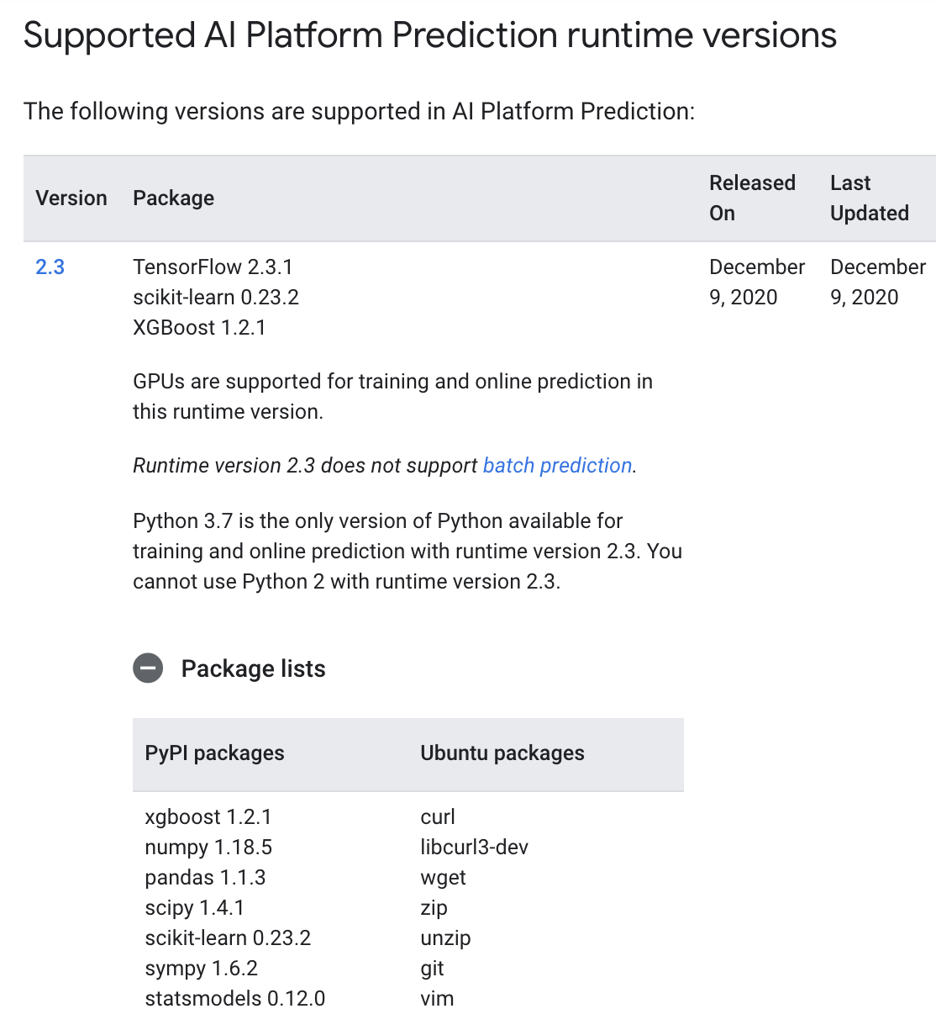
GCP runtime version
Runtime version is container image
Each AI Platform Prediction model runs in a container

Slide 39
GCP runtime version
How to use a model with PyTorch?
How to use other packages?
How to use different combinations of packages?
How to specify other stuff e.g.:
CUDA version
Python version
Download random things from the Internet?

Slide 40

Custom container
An isolated, lightweight environment for running an application on the host OS

Slide 41
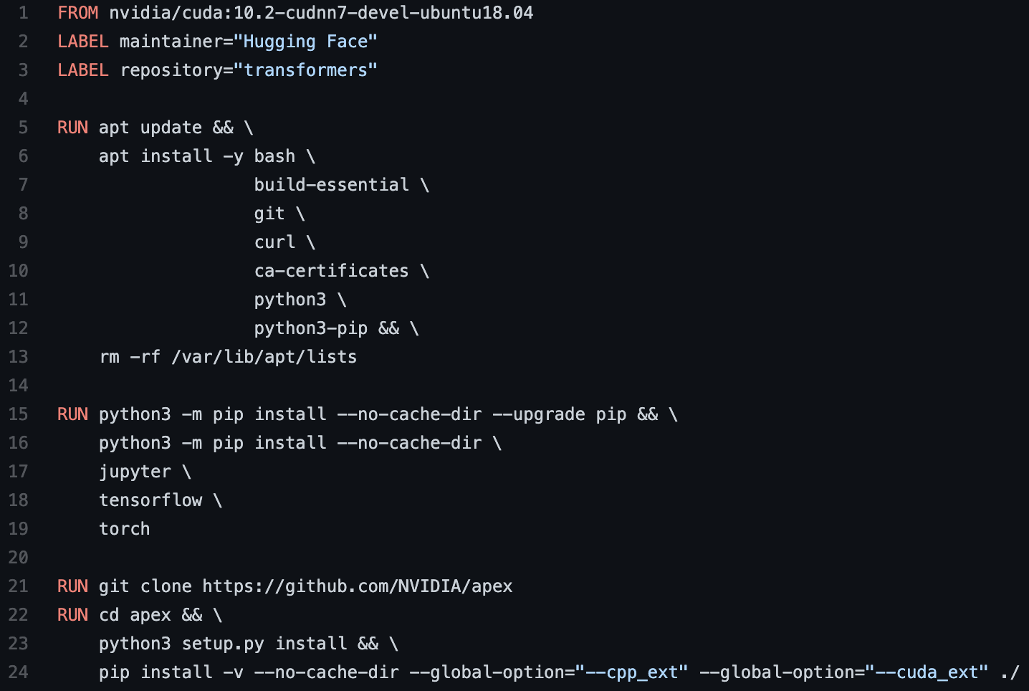
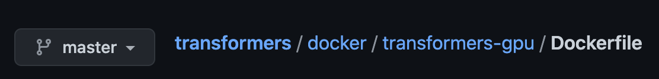
Creating a Docker image with Dockerfile

Slide 42
Docker image
Base image
Layers

Slide 43
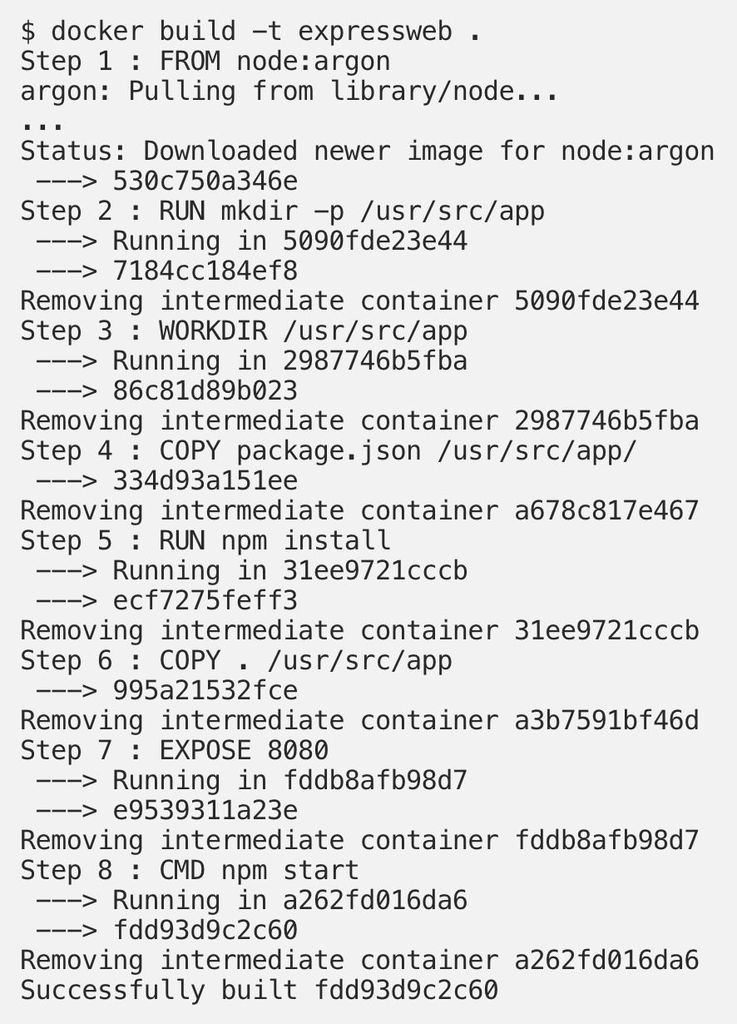
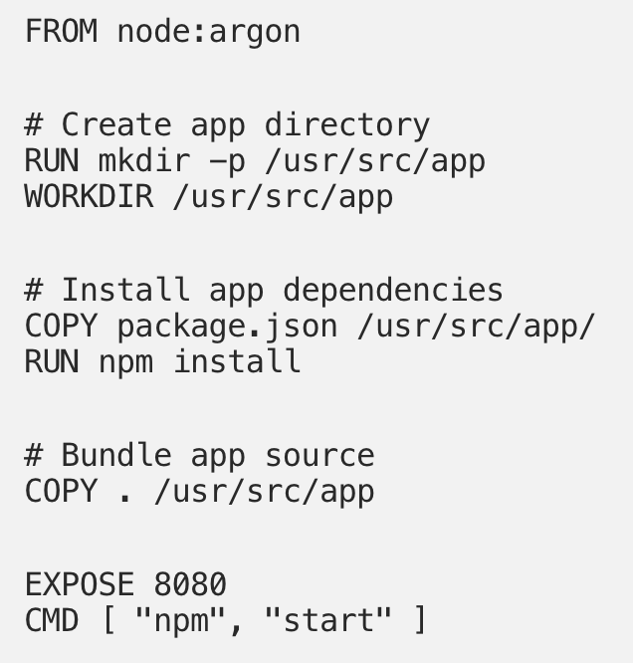
Docker: layers (immediate images)
A layer is files generated from running a command in Docker
Digging into Docker layers (Jessica G, 2016)

Slide 44
Docker: layers (immediate images)
Faster rebuild
Layers can be reused by different containers
Easier to revert back to the last layer
Digging into Docker layers (Jessica G, 2016)

Slide 45
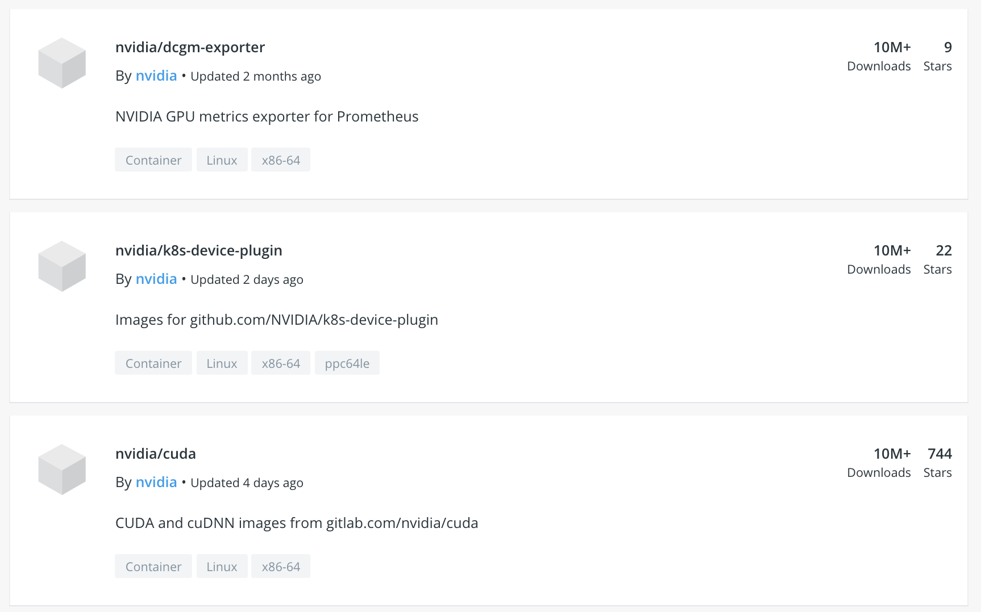
Container registry
Single place to manage docker images
Docker Hub
Private solution

Slide 46
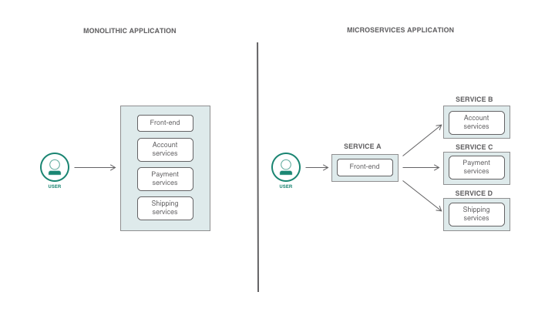
Container: microservices
Monolith: all application logics in one instance
Microservices:
break application logics into smaller services
each service in its own container
Why should you use microservices and containers? (IBM)

Slide 47
Container: microservices
Reduced complexity: each developer works on a smaller codebase
Faster development cycle: easier review process
Flexible stack: different microservices can use different technology stacks
Why should you use microservices and containers? (IBM)

Slide 48
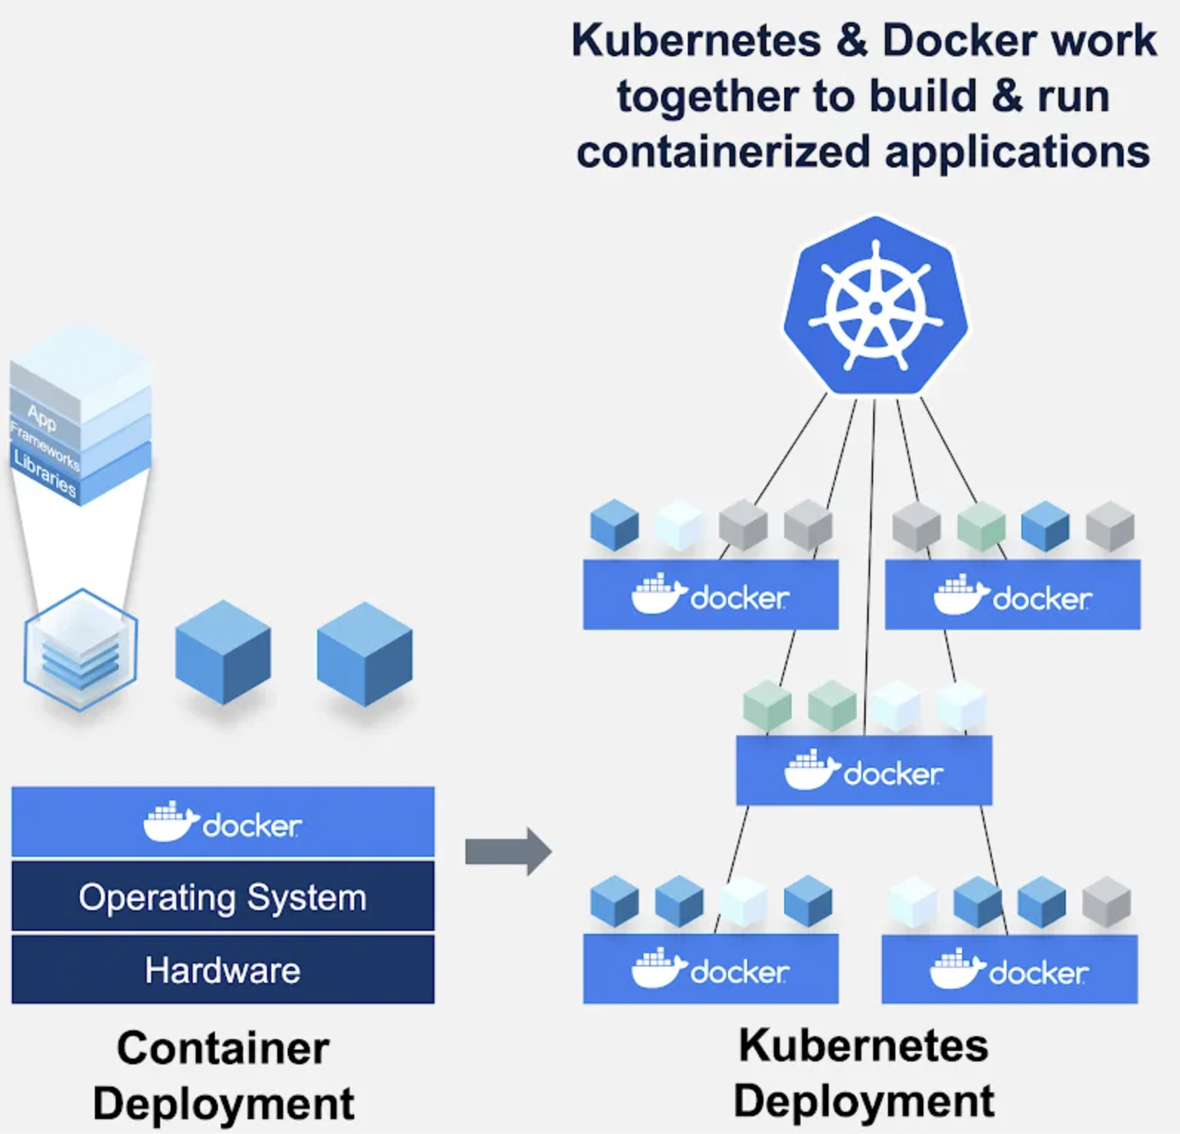
Kubernetes: container orchestration
How to manage multiple containers?
If a container goes down, how to restart/replace it?
How to allocate resources between containers?
Security access
...
Top Questions Answered: Docker and Kubernetes? I Thought You Were Competitors! (Docker blog, 2019)

Slide 49
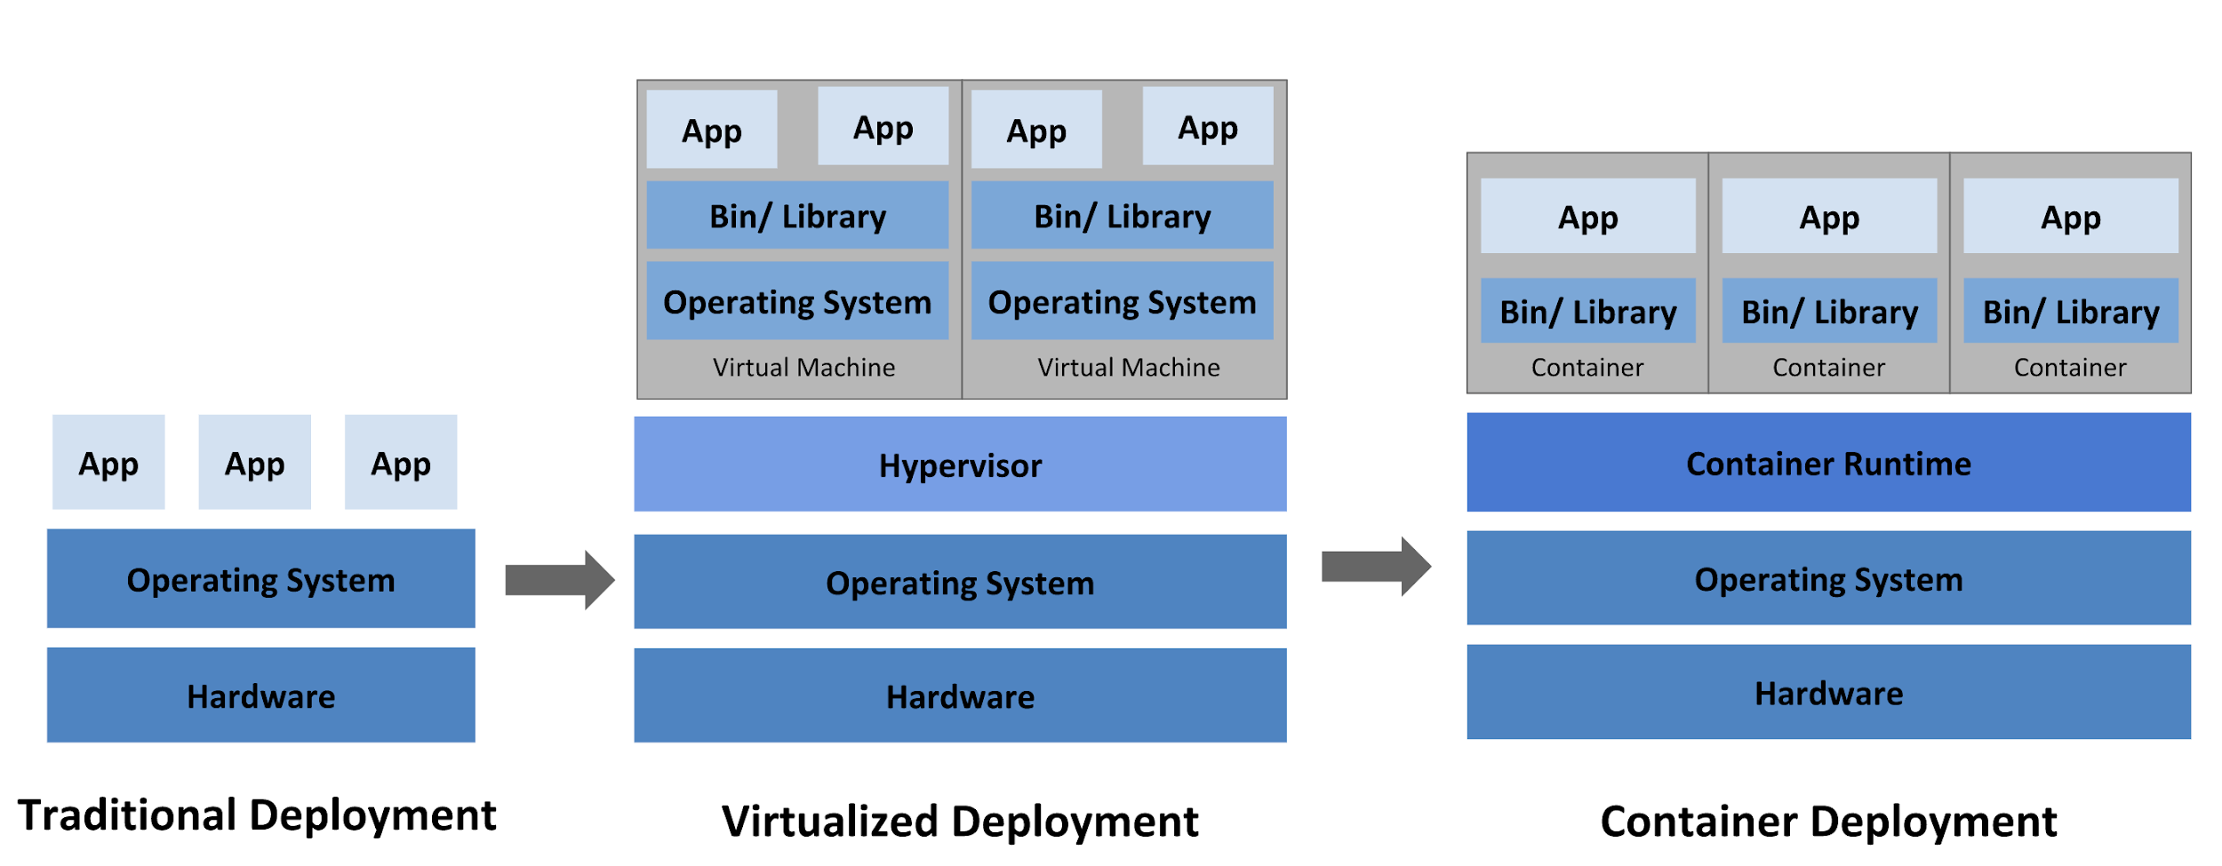
Container isn’t the only virtualization technology
https://kubernetes.io/docs/concepts/overview/what-is-kubernetes/
Notes:
Early on, organizations ran applications on physical servers. There was no way to define resource boundaries for applications in a physical server, and this caused resource allocation issues. For example, if multiple applications run on a physical server, there can be instances where one application would take up most of the resources, and as a result, the other applications would underperform. A solution for this would be to run each application on a different physical server. But this did not scale as resources were underutilized, and it was expensive for organizations to maintain many physical servers.

Slide 50
VMs vs. containers
Virtual machine | Container
Full virtualization | OS-level virtualization
Simulates unmodified “guest” OS | Creates isolated user space on same OS
Can run any OS (e.g. Windows on Linux) | Can only accommodate different distributions of same OS
Heavy | Lightweight
Startup time: minutes | Startup time: seconds

Slide 51
VMs vs. containers
Fascinating history on how legacy systems motivated virtualization technology
Virtual machine | Container
Full virtualization | OS-level virtualization
Simulates unmodified “guest” OS | Creates isolated user space on same OS
Can run any OS (e.g. Windows on Linux) | Can only accommodate different distributions of same OS
Heavy | Lightweight
Startup time: minutes | Startup time: seconds

Slide 52
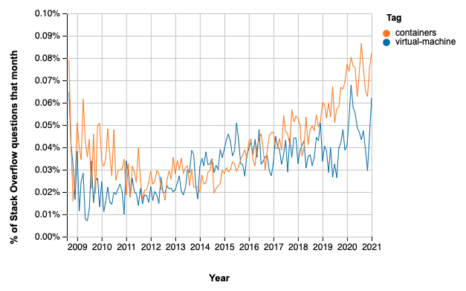
VM vs. container
https://insights.stackoverflow.com/trends

Slide 53
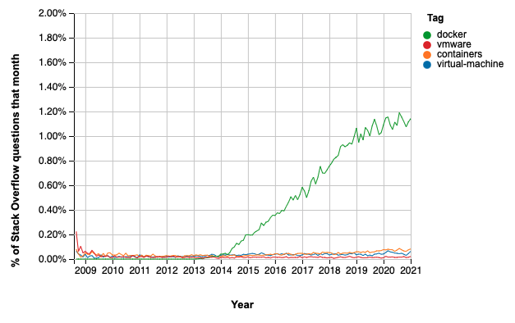
VM vs. container
https://insights.stackoverflow.com/trends

Slide 54
Test in production

Slide 55
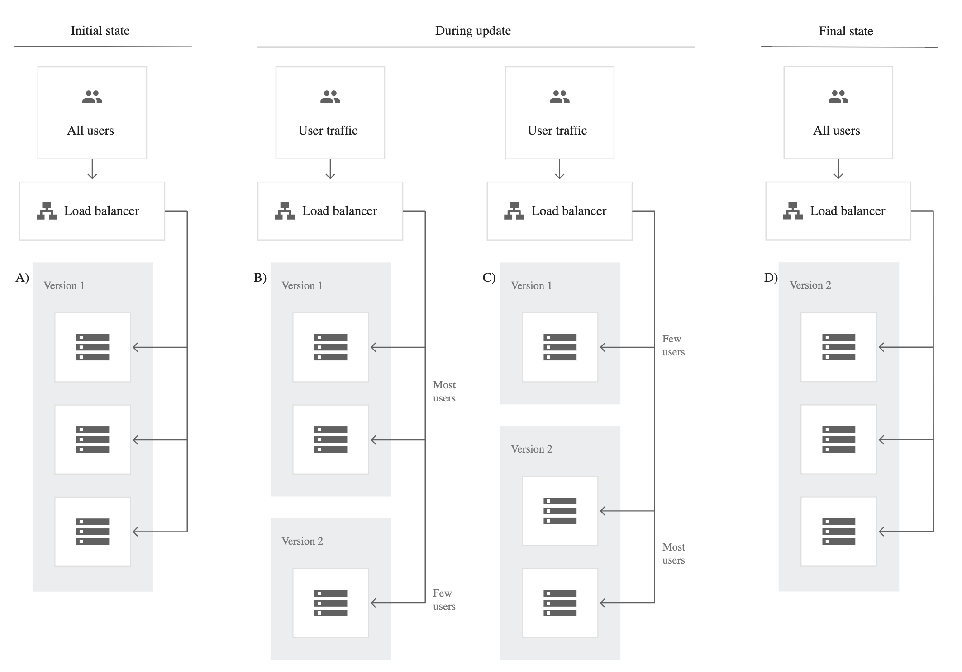
Canary testing
New model alongside existing system
Some traffic is routed to new model
Slowly increase the traffic to new model
E.g. roll out to Vietnam first, then Asia, then rest of the world
Application deployment and testing strategies (Google)

Slide 56
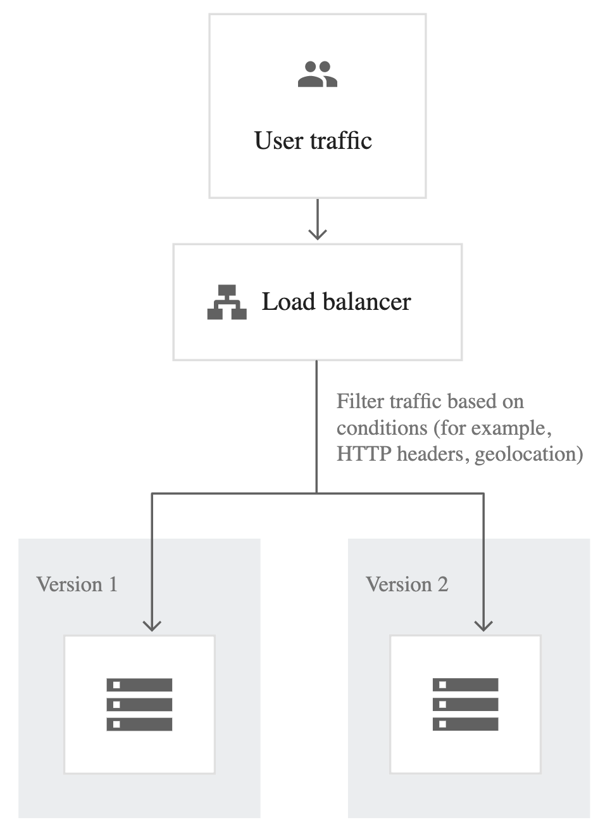
A/B testing
New model alongside existing system
A percentage of traffic is routed to new model based on routing rules
Control target audience & monitor any statistically significant differences in user behavior
Can have more than 2 versions
Application deployment and testing strategies (Google)

Slide 57
Interleaved experiments
Especially useful for ranking/recsys
Take recommendations from both model A & B
Mix them together and show them to users
See which recommendations are clicked on

Slide 58
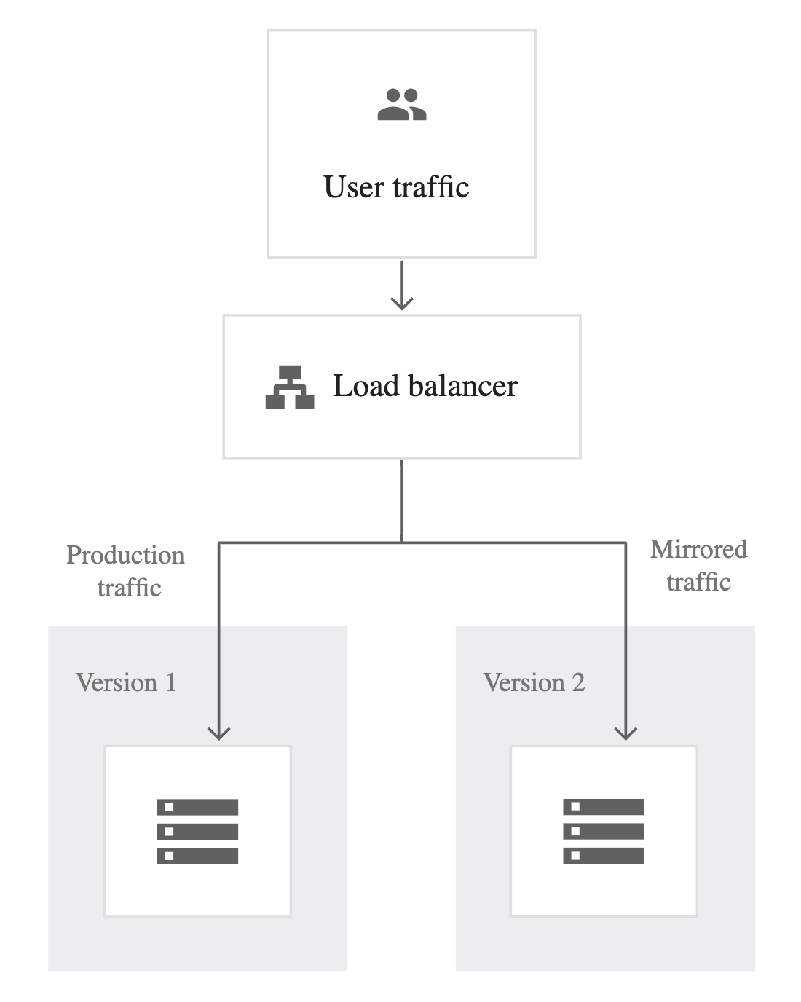
Shadow testing
New model in parallel with existing system
New model’s predictions are logged, but not show to users
Switch to new model when results are satisfactory
Application deployment and testing strategies (Google)

Slide 59
Test internally first
Use features even as they’re in development
Share internally before externally
⚠ You and your coworkers are not typical users ⚠

Slide 60
OpenAI API workshop Andrew Mayne

Slide 61
Andrew Mayne
Creative Applications @ OpenAI

Slide 62
GPT-3 is a prediction machine: It’s trying to predict what should come next based upon what it has learned about the world through text.

Slide 63
A prompt is text we send to GPT-3 for it to make a prediction about what should come next.

Slide 64
GPT-3 isn’t programmed to do any specific task. It can perform as a chatbot, a classifier, a summarizer and other tasks because it understands what those tasks look like on a textual level

Slide 65
How to create a prompt
1. Define the problem you’re trying to solve (classification, Q&A, creative, etc.).
2. Ask if there is a way to get a solution with zero examples.
3. If you think you need examples, go to step 2 and think really, really hard.
4. Think of how someone might encounter this request in the world of text and write a prompt based on that.
5. If you need examples, use as few as possible and add counter examples.

Slide 66
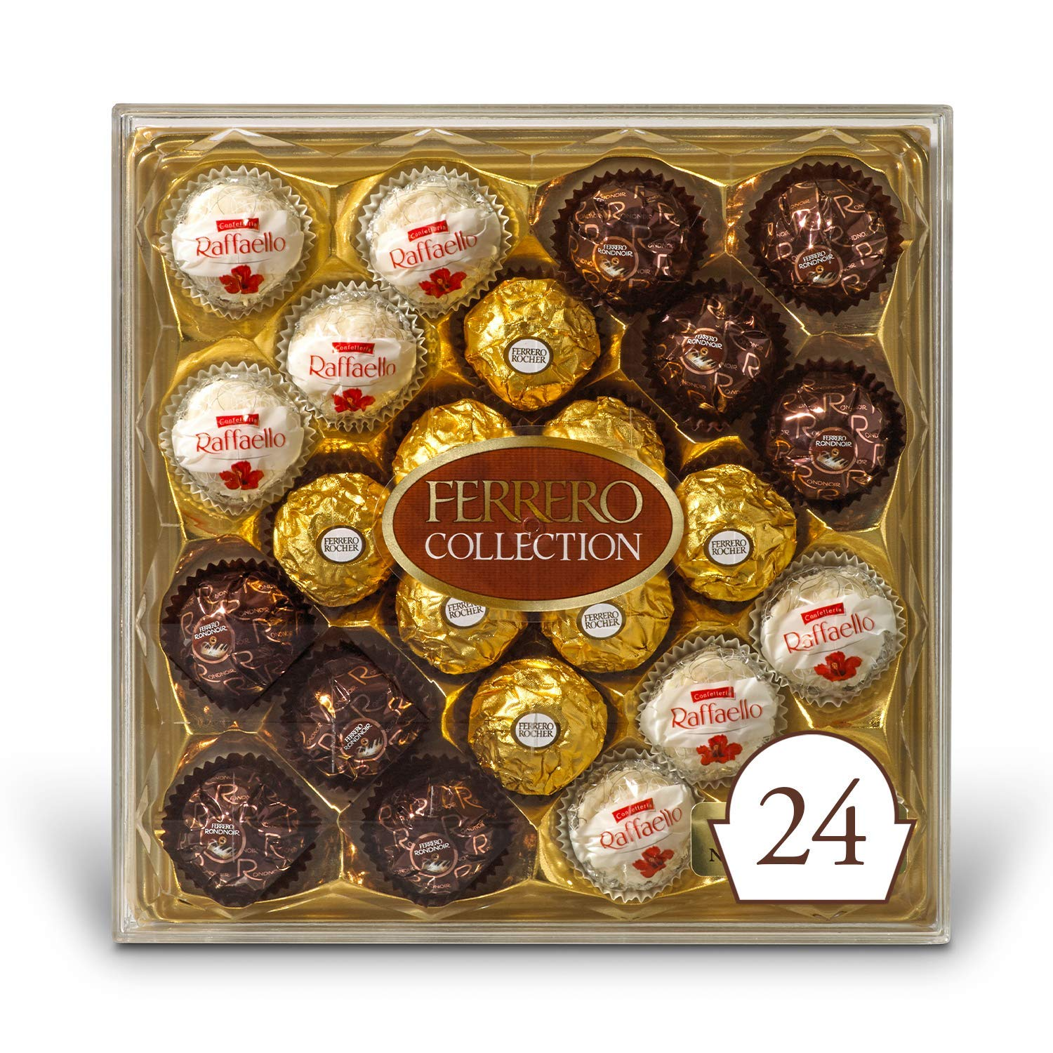
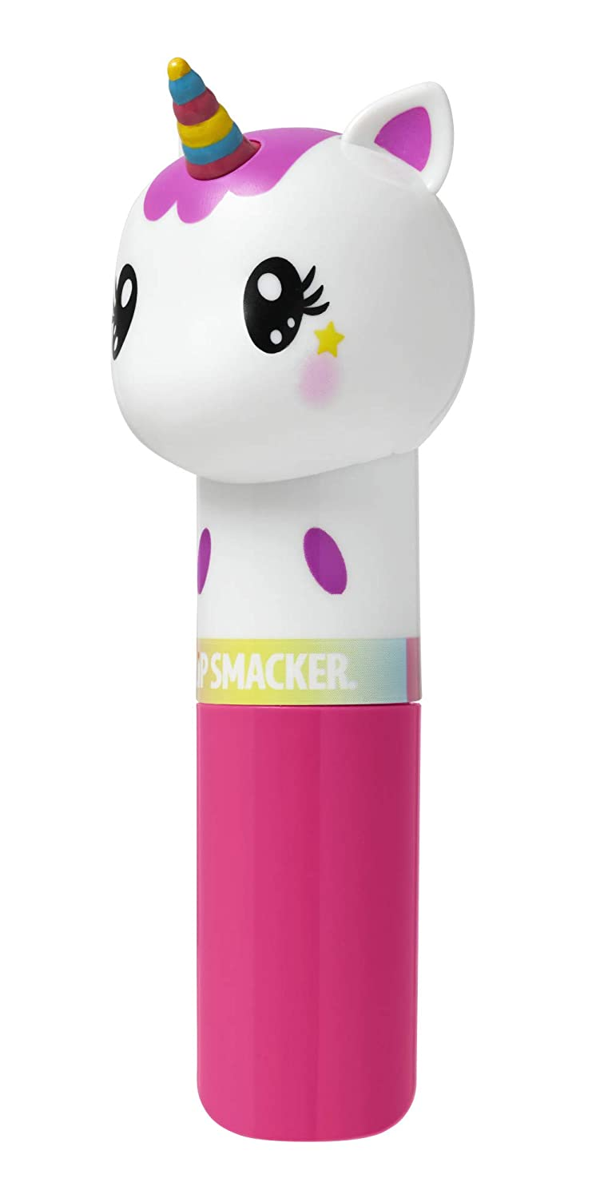

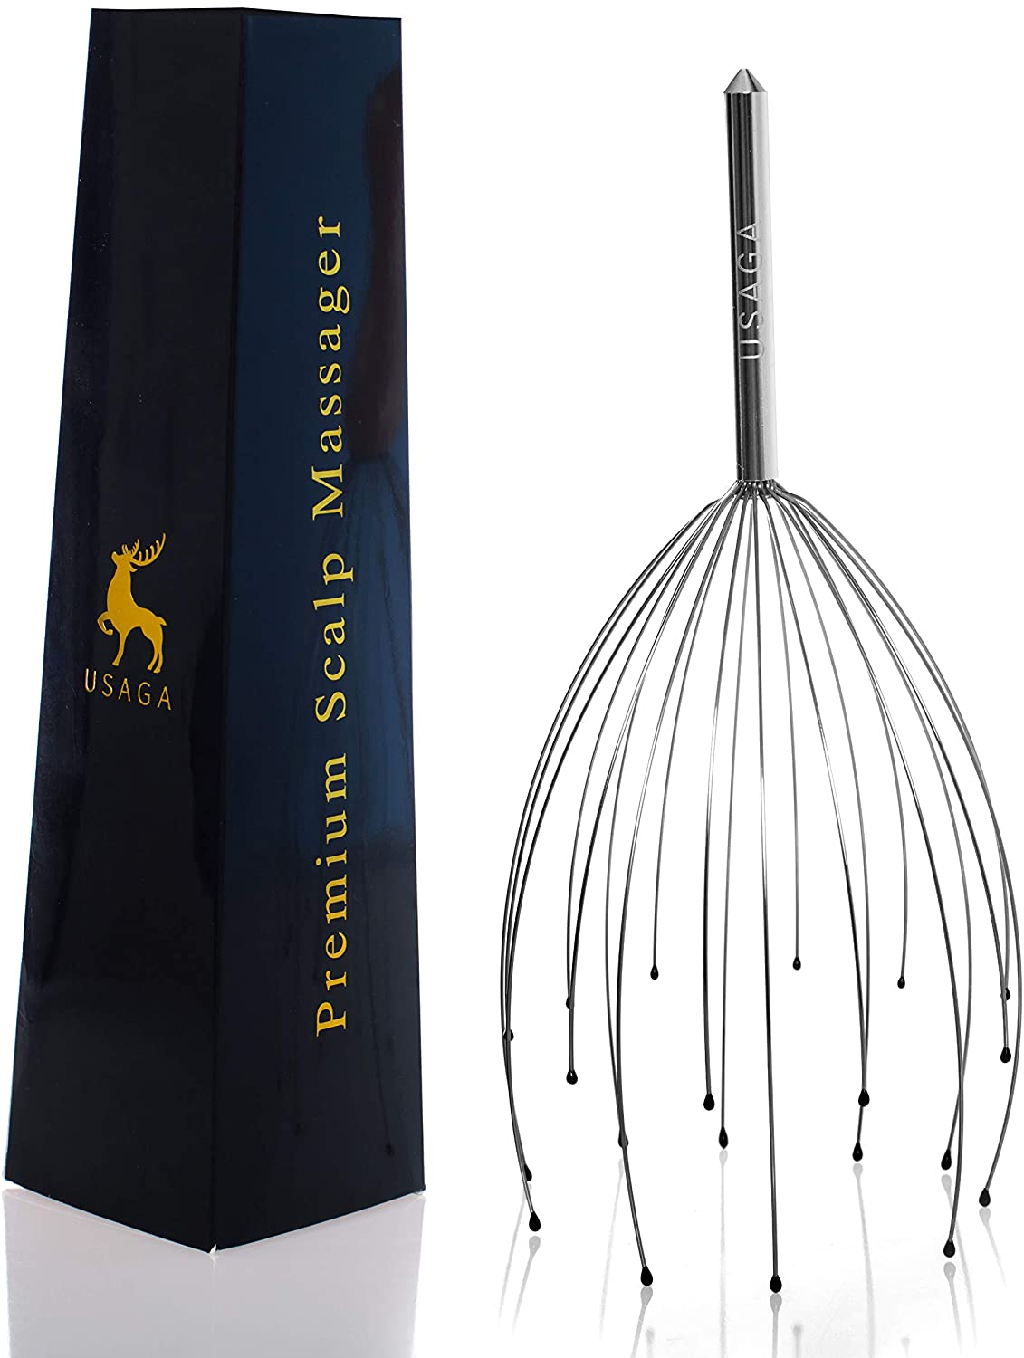


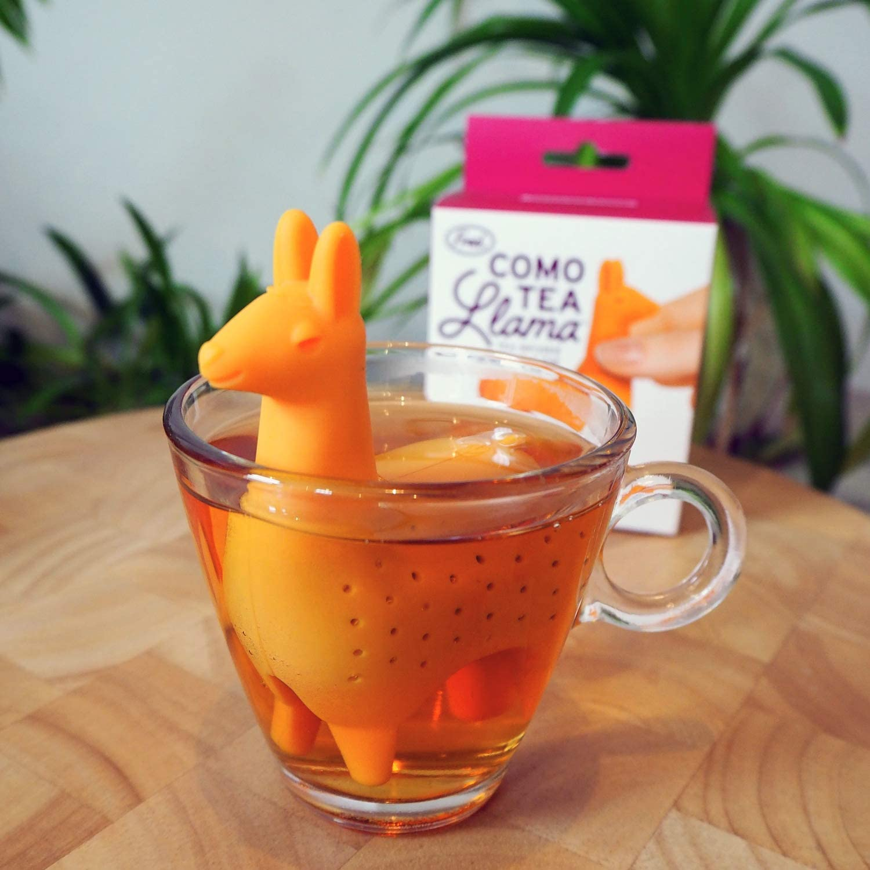

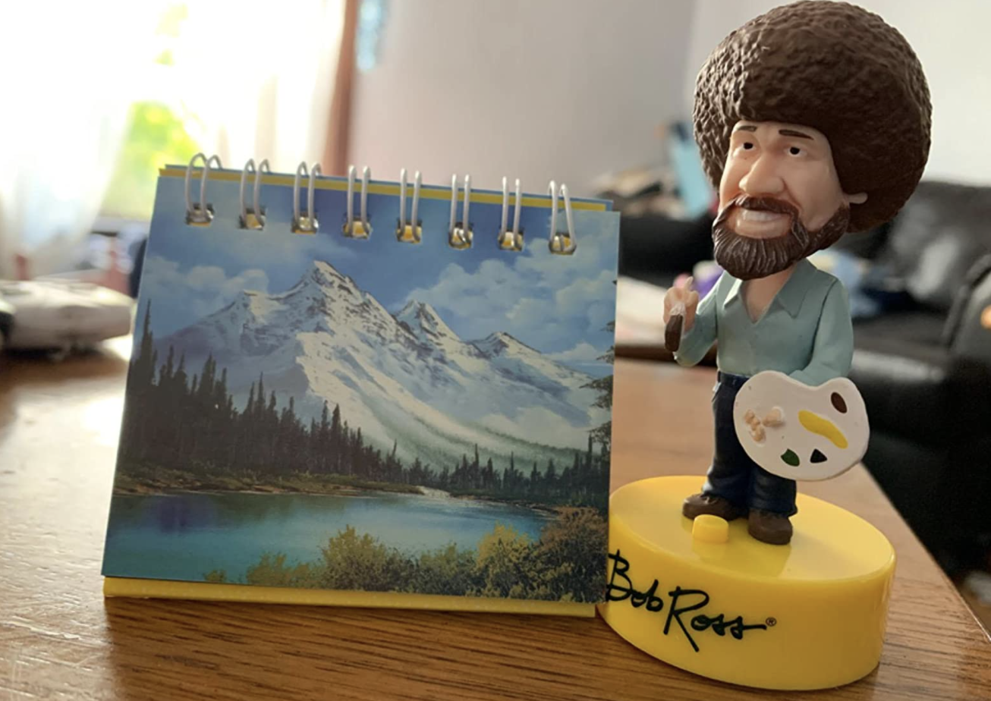

1 2 9 4 5
3 6 7 8 10

Slide 67
Machine Learning Systems Design
Next class: Distributed training & framework tutorials
cs329s.stanford.edu | Chip Huyen

